Slide 1

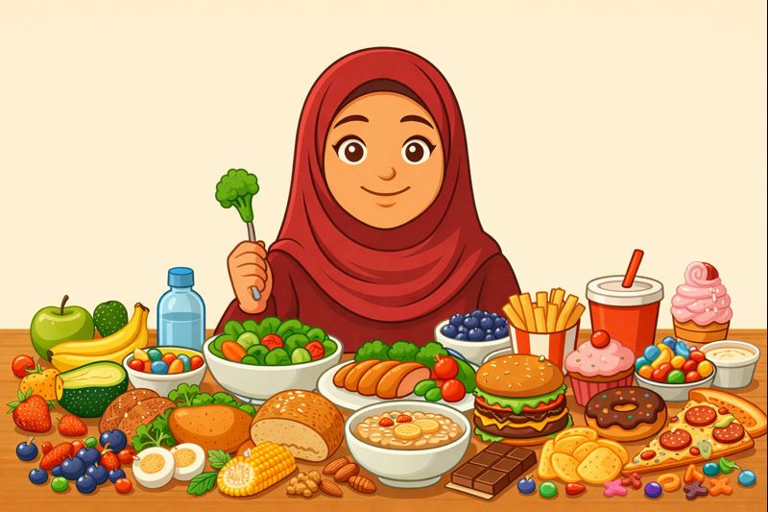
Nutrition
Islam Teaches Balance

Slide 2
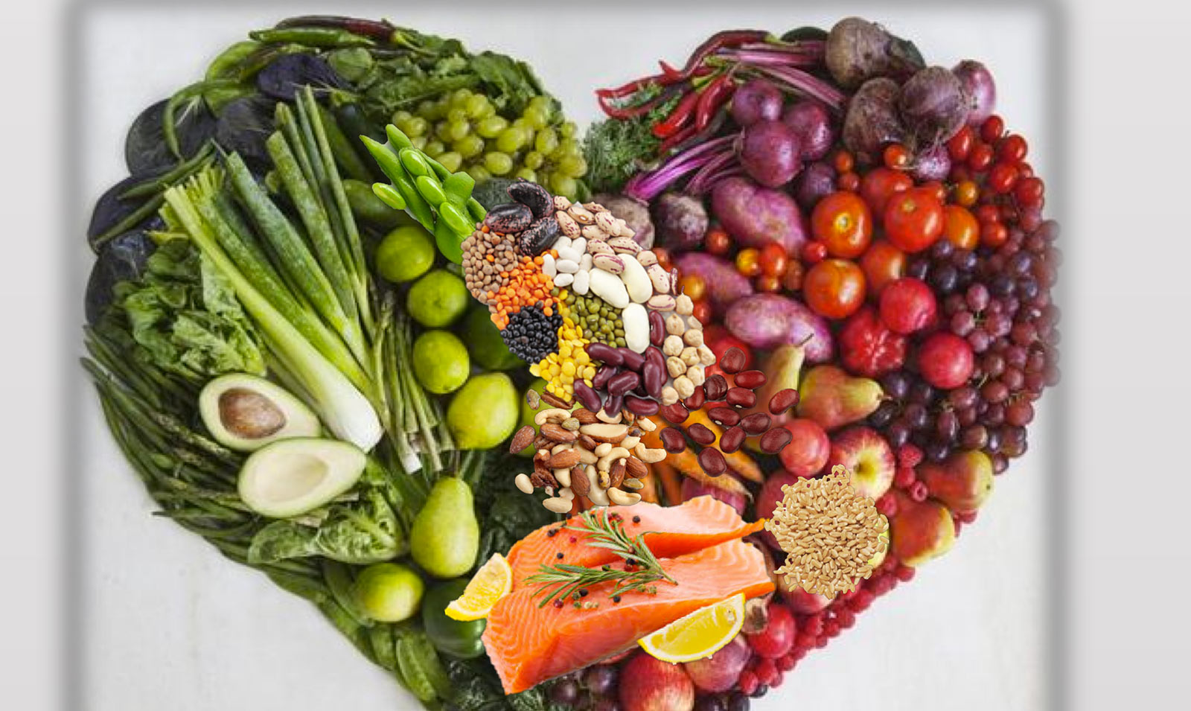
Discussion Question:
What does nutrition mean to you?
Discussion Question:
What does nutrition mean to you?
(healthy) food and water
understanding what is good for our body and what is bad
eating to help our body grow
blessings from Allah
being able to satisfy our hunger
………..

Slide 3
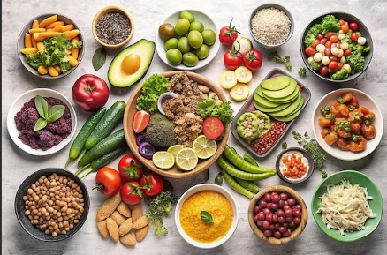
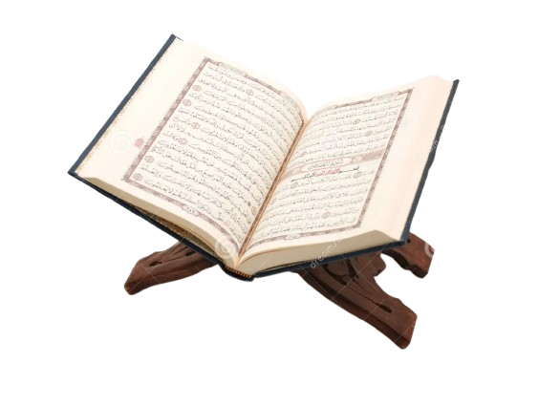
What is Nutrition?
Nutrition is all about eating a regular, balanced diet. Good nutrition helps fuel our body. The foods we eat supply the nutrients our body needs to maintain our brain, muscle, bone, nerves, skin, blood circulation, and immune system. Proper nutrition also helps protect us from illness and disease such as heart disease, diabetes, cancer etc.
“O ye men! eat of what is lawful and good in the earth…” (Holy Qur’an 2:169)
→ This means we should choose wholesome and healthy foods to eat.

Slide 4
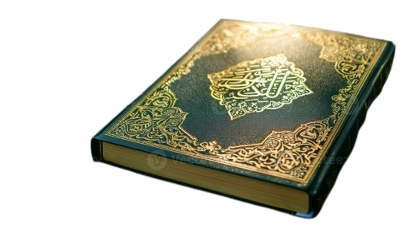
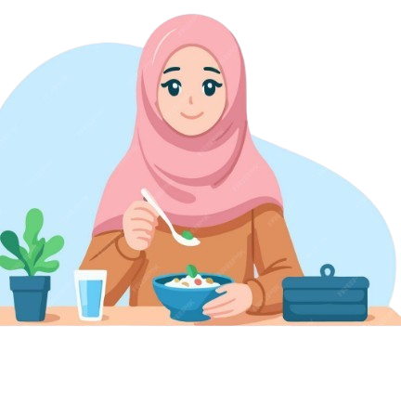
“…and eat and drink but exceed not the bounds; surely, He does not love those who exceed the bounds.” (7:32)
Allah says in the Holy Qur’an:
→ Allah loves moderation, so we should adopt it too!

Slide 5
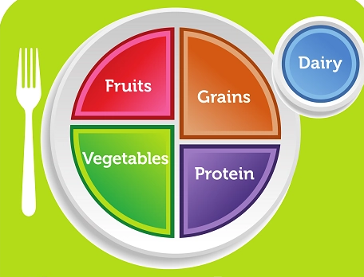
Healthy Eating Plate

Slide 6

Understanding the Healthy Eating Plate
Grains: Preferably whole grains, such as whole-wheat bread or pasta, oatmeal, popcorn, quinoa, or rice
Protein: Seafood, meat, chicken, eggs, beans, peas, nuts and seeds
Vegetables: All sorts of colorful vegetables
Fruits. Eat the rainbow! We should try all sorts of fruits that Allah has created for us.
Dairy. Dairy products, such as milk, yogurt and cheese.
Don’t forget to drink 8 cups of water daily!

Slide 7
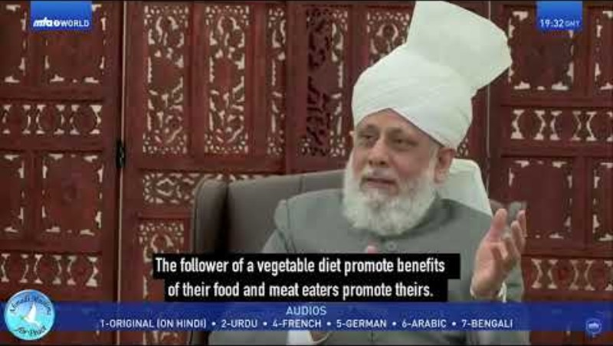

Slide 8

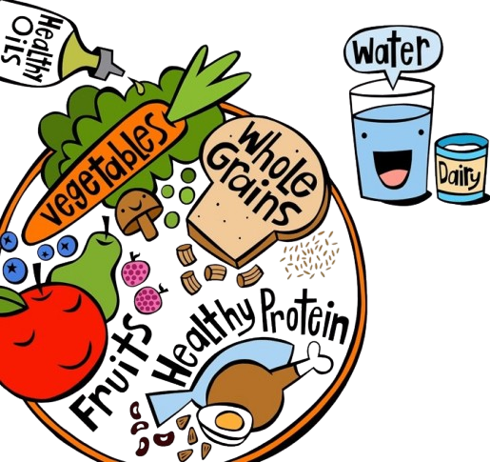
Healthy eating in childhood and adolescence promotes growth and development.
Why Should We Eat Healthy?
Healthy eating habits can prevent a number of harmful health conditions.
Healthy eating can help us achieve and maintain a healthy body weight.

Slide 9

How to Eat Right
Understanding ‘healthy’:
Food is healthy when it maintains or improves overall health by providing the body with essential nutrients (nutrients are vitamins, minerals, and other substances in food that our bodies need to work properly.)
We should look for foods that are not highly processed, that are close to their natural form, instead of foods with lots of added sugar, salt, or chemicals.
Avoid overeating!
The Holy Prophet Muhammad^{(sa)} said that we should fill our stomach up to 1/3 with food, 1/3 with water and 1/3 with air.

Slide 10
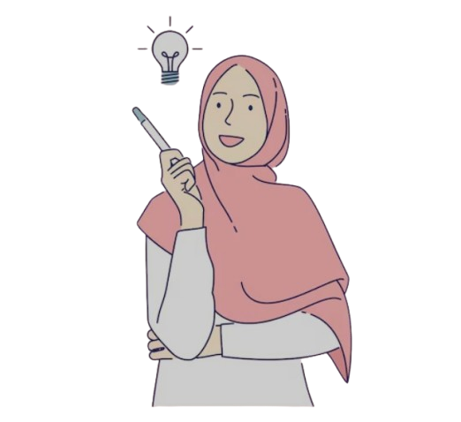

“It’s okay to enjoy ‘unhealthy’ foods
once in a while, as long as we are not
making it a habit.
The Holy Prophet (pbuh) taught us moderation.’”
“But I like eating foods
that are considered unhealthy.”

Slide 11

REMEMBER: Islam Teaches Balance!
The Holy Prophet^{(sa)} reinforced this principle when he said:
→“Khairul umuri ausatuha”, which means:
The best of affairs are those done in moderation.
(Sahih Al-Bukhari)

Slide 12
Resources:
https://alislam.org/quran/app/1?options=sc
https://www.cdc.gov/school-nutrition/facts/index.html
https://www.mayoclinic.org/healthy-lifestyle/childrens-health/in-depth/nutrition-for-kids/art-20049335
https://nutritionsource.hsph.harvard.edu/kids-healthy-eating-plate/
https://sunnah.com/ibnmajah:3349
FMI | What Exactly is “Healthy?” Explore the Updated FDA Definition
Healthy diet - Wikipedia
Kennedy, Rollins Unveil Historic Reset of U.S. Nutrition Policy, Put Real Food Back at Center of Health | HHS.gov
Nutrition - Harvard Health

